Slide 2
Session Topics
Calendar Updates for 2019-2020
Statewide/ National Chapter Campaigns
Competitive Event Changes for 2019-2020
Texas DECA State and District Changes
Texas DECA Board Policy Changes

Slide 3
2019-2020 DECA Calendar
Professional Development
Statewide Teacher Training
- September 18th– Austin
- Room Block will be available the 17th
DECA Dues – October 15th
National DECA Month
November
Advocacy/CTE Month
February
Conference Dates
Southern Region – November 15-17, Washington, D.C. “The Ultimate DECA Power Trip”
State CDC – February 20-22, 2020 Fort Worth, Texas
Thursday - Saturday
ICDC – April 29 – May 2, 2020, Nashville, Tennessee Wednesday-Saturday
www.deca.org/events/

Slide 4
Southern Region/Power Trip
November 15-17, 2019
Registration Fee –
$130 per attendee
Deadline – Mid-October
Renaissance Downtown Hotel
~$199 per room per night

Slide 5
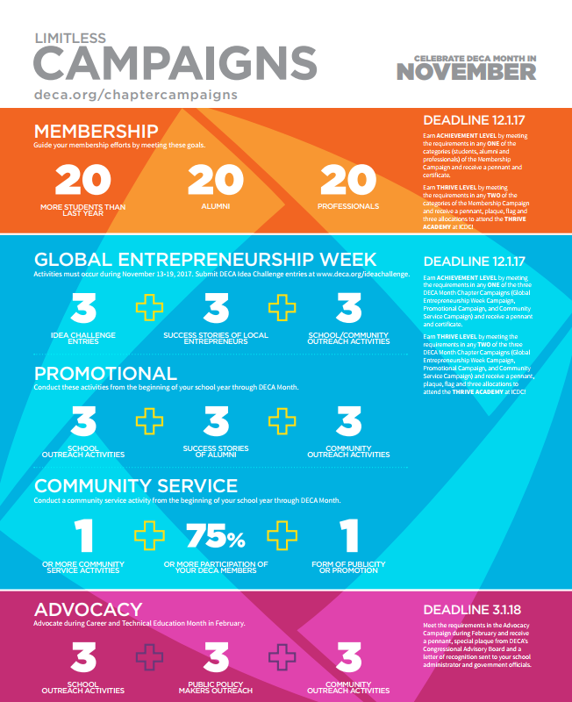
DECA Chapter Campaigns
Membership
Action Plans
GEW
Promotional
Community Service
Advocacy
Figures for 2019-2020 have not yet been published

Slide 6
DECA Chapter Campaigns
Membership
+20 students
TOTAL of 20 Alumni OR Professional
Alumni Success Stories
ANY DECA Alumni, no chapter restriction
Activities
Should be different for each campaign

Slide 7
DECA Chapter Campaigns
Global Entrepreneurship Week
Success Stories are of LOCAL Entrepreneurs – Not Limited to Your Chapter!

Slide 8
Texas DECA Membership Campaign
2018-2019 Numbers
Current Membership – 15,304 – Largest Association
ICDC Allocations– 9 for Role Plays, 8 for Prepared
2019-2020 Campaign
Three Campaigns
Current Chapters – October 15 – Students Only
Bronze = +10, Silver = +30, Gold = +50
Professional/Alumni – December 1
Corporate = +20, Enterprise = +40
New Chapters – December 1 – Total Membership
Tier 1 = 20 members, Tier 2 = 40 Members

Slide 9
Statewide Service Project
Districts will continue to run District-Wide Service Projects
Statewide Awareness Campaign will focus on raising awareness for Childhood Cancers
Chapters can earn recognition and rewards for their participation in the Marketing and Media Challenge
Awareness Event
Social Media Campaign
Video

Slide 10
DECA Scholarships
Scholarship Deadlines
Students | January
Advisors | March
Over $300,000 in scholarships awarded at ICDC
Check the website | deca.org/scholarships

Slide 11
Texas DECA Scholarships
Scholarship Deadline - DUE Two (2) Weeks Prior to District CDC
2018-2019 – 5 $1,000 Scholarships Awarded, with only 17 applications! Have your students apply!
Applications available on www.texasdeca.org
Will be emailed by DECA Staff and District Directors.

Slide 12
Competitive Events
CHANGES AND UPDATES

Slide 13
Written Event Changes
Events formerly known as Chapter Team Events are now PROJECT MANAGEMENT EVENTS.
Event names and rubrics have changed, but the projects are still very similar:
2018-2019 Event
Creative Marketing
Community Service
Entrepreneurship Promotion
Financial Literacy
Learn and Earn
Public Relations
2019-2020 Event
Business Solutions
Community Giving
Career Development
Financial Literacy
Sales Project
Community Awareness

Slide 14
Professional Selling Events
Professional Selling Topic:
For 2019-2020 you will assume the role of a sales representative of a cloud-based technology firm that specializes in workplace collaboration, productivity and project management. The chief operations officer of a new startup has scheduled a meeting with you because he/she has a desire to implement this technology within the startup, which has 25 employees. The chief operations officer wants to learn about your technology solution’s features and why your solution is superior to its competitors.

Slide 15
Professional Selling Events
Hospitality and Tourism Professional Selling For 2019-2020 you will assume the role of director of sponsorships for a local event taking place within your community. You are meeting with a local business that has interest in becoming a sponsor of the event. In the meeting, you should explain the sponsorship program, various sponsorship packages available and recommend the sponsorship level appropriate to the business.

Slide 16
Professional Selling Events
Financial Consulting For 2019-2020 you will assume the role of a financial consultant. A client has scheduled a meeting with you because he/she would like to learn more about the online features available from your organization for financial management. The client would like for you to share and explain different online customization tools for banking and portfolio management.

Slide 17
Operations Research Events
The 2019-2020 topic for each career category is the development of a strategy to improve a company’s reputation and online brand presence. Participants will collaborate with a local business or organization to analyze current perceptions of the company or organization as well as its online brand presence. Participants will then present a strategic plan to enhance the company’s reputation and online brand presence.

Slide 18
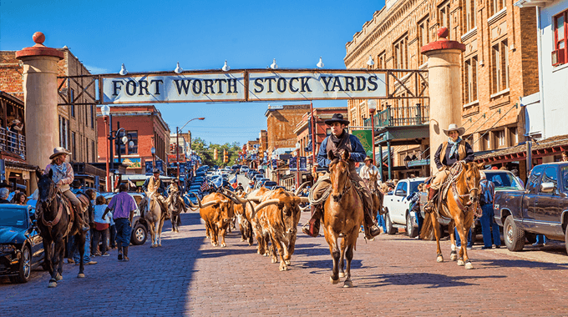
State CDC 2020
Fort Worth
February 20-22, 2020
Registration Due Date:
January 30th
Payment Due Date: February 14th
****District CDC’s will be from Jan 13-18

Slide 19
State CDC 2020
Schedule is Thursday-Saturday
ONE OPENING SESSION to begin at 8:00 pm Thursday night
All competitive events will take place Friday from 7:30 am - 4:30 pm
Business Session take place Friday afternoon
Only Voting Delegates will be REQUIRED to attend, everyone will be ABLE to attend
Officer Candidate Meet and Greet Friday 3:00 – 4:00 pm
Networking opportunity for all members and officer candidates

Slide 20
State CDC 2020
Entertainment Friday night
Tentative: Casino Night + MORE
Closing Session
Grand Awards will begin at 9:00 am Saturday morning
Estimated to end at 12:30 pm
Newly elected and current officers
Will have Leadership Training session Saturday/Sunday

Slide 21
State CDC 2020
Minor changes will be coming for the on-site registration of written events
Continue with online submission of projects
Details expected by November 1

Slide 22
State Officers
Left to Right:
Top Row: Gaby Romero (VP of Engagement), Sikyra Castle (President), Marandy Burrow (VP of Leadership Development)
Bottom Row: Parth Parikh (VP of Competition), Chris Bou-Saada (VP of Media), Shrey Addagatla (VP of Chapter Management)

Slide 23
Leadership Opportunities
Officer candidates will run at large at State CDC
6 Positions will be filled
The candidate with the most points will be elected President and the remaining 5 winning candidates will be named Vice President
Specific duties and titles for each Vice President will be decided during the training session that will follow on Saturday and Sunday immediately following State CDC awards session (ex: Vice President of Operations; Vice President of Social Media)

Slide 24
Board of Directors Update
District 9 – Nina Wilson
Executive Committee 2019-2020
Chair – Kim Adams (D11) Chair-Elect – Traci Buckner (D6) Secretary – Diana Salazar (D2) Treasurer – Mike Miller (D3)

Slide 25
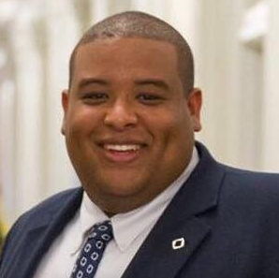
Texas DECA Staff Update
Welcome Johnnie Hubbard Assistant Director
hubbard@texasdeca.org

Slide 26
Texas DECA Staff Update
Texas DECA will be moving to a new office space in Keller (Fort Worth)
Direct phone line updates will be shared in early August
W9 will remain the same – payments will still go to the PO Box

Slide 27
Practice Testing
Texas DECA Board of Directors is ONCE AGAIN giving every student member FREE, UNLIMITED, online practice testing
Students will receive a unique username once they are submitted in membership
Can Log-on from any device, at any location, and at any time.
Last 8 years of exams – 4 Clusters, Principles and PFL exams
Recent exams feature the rationale for incorrect answers

Slide 28
Questions/Comments
Please contact Josh Shankle, Executive Director
shankle@texasdeca.org
PowerPoint available under the About Tab on www.texasdeca.org

