Slide 1
UNDERSTANDING
CHAPTER CAMPAIGNS
TEXAS DECA

Slide 2
What Are Chapter Campaigns?
Engagement Opportunities
Grow Student Base
Involve Parents/Families, Community Leaders, and Alumni
Impact Your Community
Share Ethical Practices
Advocate for CTE
Connect with Neighboring Schools/Chapters
Show how involved your chapter is
Provide management opportunities for your student leaders
TEXAS DECA

Slide 3
What Chapter Campaigns Are Offered?
National Chapter Campaigns
Membership
Promotional
Community Service
Ethical Leadership
Advocacy
Texas DECA Chapter Campaigns
Membership
Bring a Friend
Community Service
Texas Two Step
Chapter of the Year
TEXAS DECA

Slide 4
Benefits of Participating in the Campaigns
Recognition
Pennant, plaque, flags
Allocations for Leadership Academies at ICDC
State Level Membership
DECA+
Blazers
Shop DECA gift cards
TEXAS DECA

Slide 5
Resources to Help
Texas DECA Advisor Handbook, pages 15-17
National DECA Guide, page 17
DECA.org
Campaign Guidebook
TexasDECA.org
Chapter Management - Chapter Campaigns
TEXAS DECA

Slide 6
National Chapter Campaign
TEXAS DECA

Slide 7
National Chapter Campaign
TEXAS DECA

Slide 8
National Chapter Campaign
TEXAS DECA

Slide 9
National Chapter Campaign
TEXAS DECA

Slide 10
National Chapter Campaign
TEXAS DECA

Slide 11
Texas DECA Chapter Campaign
TEXAS DECA

Slide 12
Texas DECA Chapter Campaign
TEXAS DECA

Slide 13
Texas DECA Chapter Campaign
TEXAS DECA

Slide 14
Texas DECA Chapter Campaign
TEXAS DECA

Slide 15
Texas DECA Chapter Campaign
TEXAS DECA

Slide 16
Texas DECA Chapter Campaign
TEXAS DECA

Slide 17
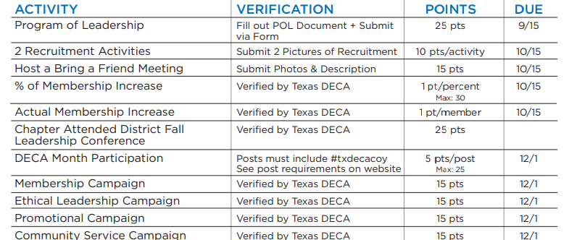
Texas DECA Chapter Campaign
TEXAS DECA

Slide 18
How do we do all of these?
You don’t!
Designate Officers or Teams to get them done.
Only choose one to start, then add more each year.
TEXAS DECA

Slide 19
Need More Information?
deca.org/campaigns
You’ll Find Ideas for All National Campaigns
Chapter Campaign Guidebook
Submission Instructions DECA Staff Contacts
+ More!
TEXAS DECA

