Slide 6
DECA’S COMPREHENSIVE LEARNING PROGRAM

Slide 17
DECA SUPPORTS EDUCATIONAL INITIATIVES

Slide 19
CAREER CLUSTERS®
An organizing tool for curriculum design and instruction
Essential knowledge and skills
Organized by 16 Career Clusters® each with career pathways
Span secondary and postsecondary education

Slide 20
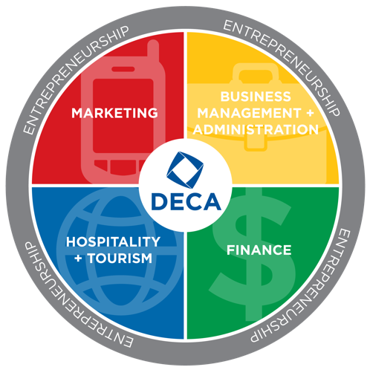
DECA SUPPORTS CAREER CLUSTERS®
DECA’s Comprehensive Learning Program supports four of the sixteen Career Clusters®
Marketing
Business Management and Administration
Hospitality and Tourism
Finance

Slide 22
NATIONAL CURRICULUM STANDARDS
Provide insight into what business leaders view as important to the success of employees
Various levels and in various specialties

Slide 23
DECA SUPPORTS NATIONAL CURRICULUM STANDARDS
Each role-play and case study use performance indicators directly linked to National Curriculum Standards
School-based Enterprise Certification Program standards are based on National Curriculum Standards
Conferences demonstrate “classroom connection”

Slide 25
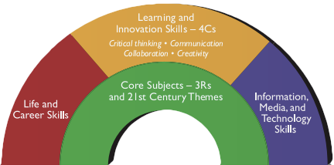
21ST CENTURY SKILLS
Learning and Innovation Skills
Critical thinking
Communication
Collaboration
Creativity

Slide 26
DECA SUPPORTS 21ST CENTURY SKILLS
Competitive Events
Corporate Partner Challenges
Educational Conferences
Emerging Leader Series
School-based Enterprises

Slide 28
PROJECT BASED LEARNING AND AUTHENTIC LEARNING
DECA activities are in the context of real business
Students engage in real, community and business-based projects
Learning becomes student-centered

Slide 30
FINANCIAL LITERACY
DECA activities are designed to measure the student’s ability to apply reliable information and systematic decision making to personal financial decisions
Areas of financial literacy:
Spending and saving
Investing
Credit and debt
Risk and insurance
Employment and income
Financial decision making

Slide 31
DEMONSTRATE DECA’S SUPPORT OF EDUCATIONAL INITIATIVES
Align your program using Career Clusters®
Use crosswalks to document how lessons support each initiative
Use DECA’s performance indicators as part of evaluation criteria when developing rubrics
Use DECA’s transcripts to demonstrate mastery of performance indicators and 21st century skills.

Slide 32
DECA’S IMPACT

Slide 36
FINAL THOUGHTS

